Slide 1
Investigating Legal Case Summarization using Domain Knowledge
Presented By: Shreya Goswami
MCS21023
Under the Supervision of:
Dr.Naveen Saini

Slide 2
Outline of the Presentation
Introduction
Motivation of the work
State-of-the-art techniques/works
Exact work to solve
Novelty of the work
Difference of the work done in second semester and current semester
Proposed Methodology
Experimental Setup: Dataset, Parameters, Evaluation Measures
Results and Comparative Analysis
Limitation of work
Future Research Plan
Conclusion
References

Slide 3
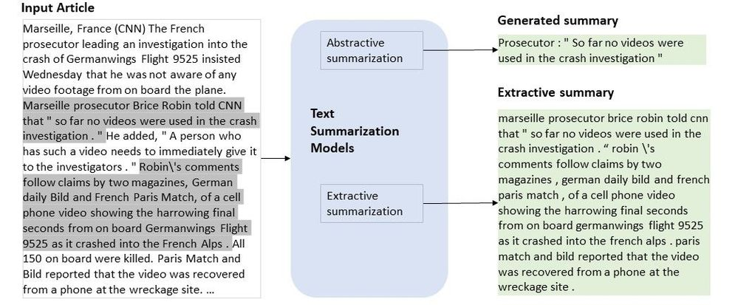
Introduction
Text summarization is the process of distilling the most important information from a source(s) to produce a compressed version.
Generally, the summary should not be longer than half of the original text.
This method has been explored for summarizing scholarly, scientific as well as news articles and is fairly new in the Legal domain.

Slide 4

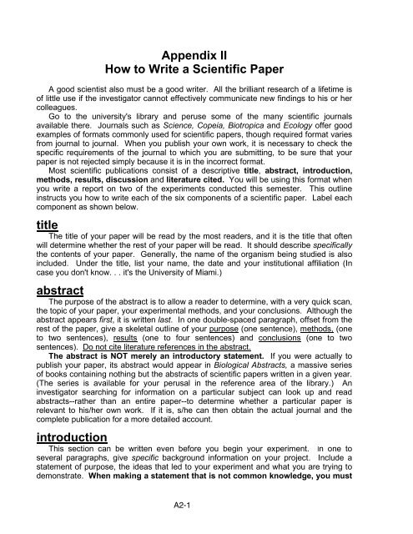
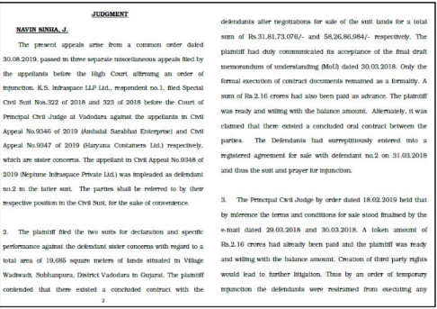
Areas and Applications
News Documents
Scientific Documents
Microblog Summarization
Meeting Summarization
Legal Case Documents

Slide 5
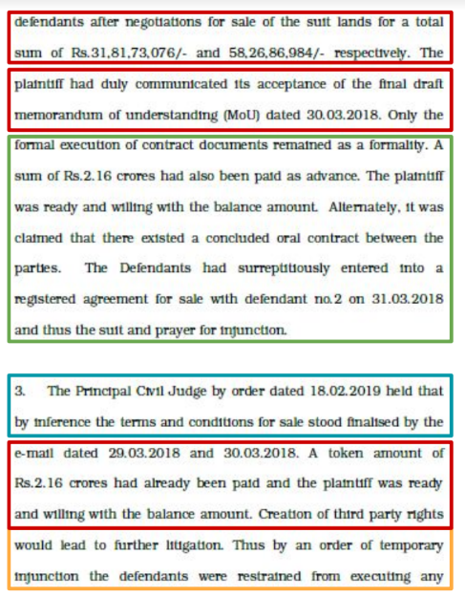
Snapshot of a Legal Case Document
Facts: chronology of events that led to filing the case
Issue: legal issues being discussed
Ruling by Lower Court: judgements given by lower Courts
Argument: arguments of the contending parties
Statute: citations to established laws by the current case
Precedent: citations to prior cases by the current case
Ratio of the decision: rationale of the Court for the final ruling
Final Judgement: conclusion of the Court

Slide 6

Why is it needed?
Often law practitioners/academicians wish to read only the summary of particular segments of the document (e.g., only the facts of a case, or the legal issues involved in a case)

Slide 7
What should the summary contain?
Each segment should be summarized well and have a representation in the final summary.
Important parts of each segment should be present in the summary.
Final Summary

Slide 8
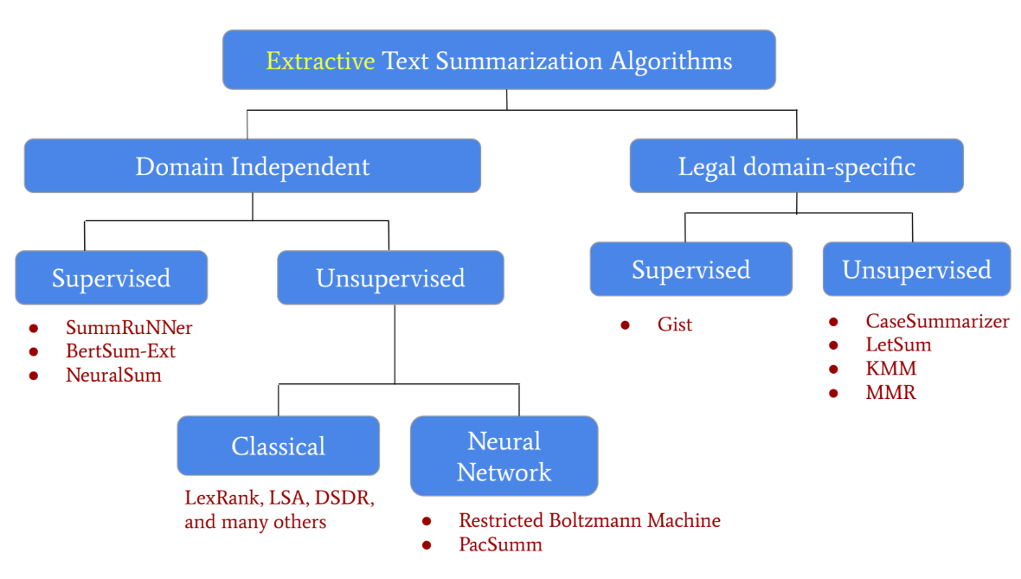
State-of-the-Art Techniques/Works

Slide 9
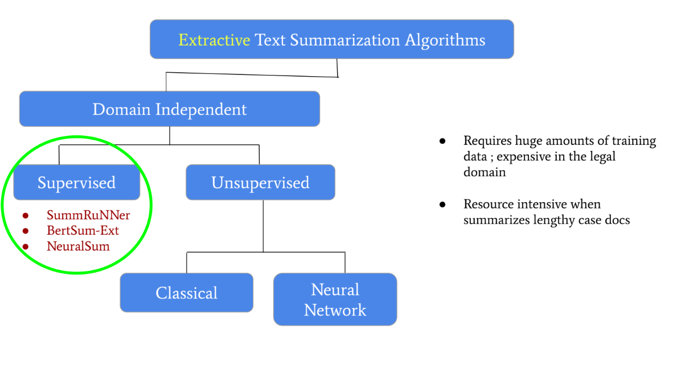
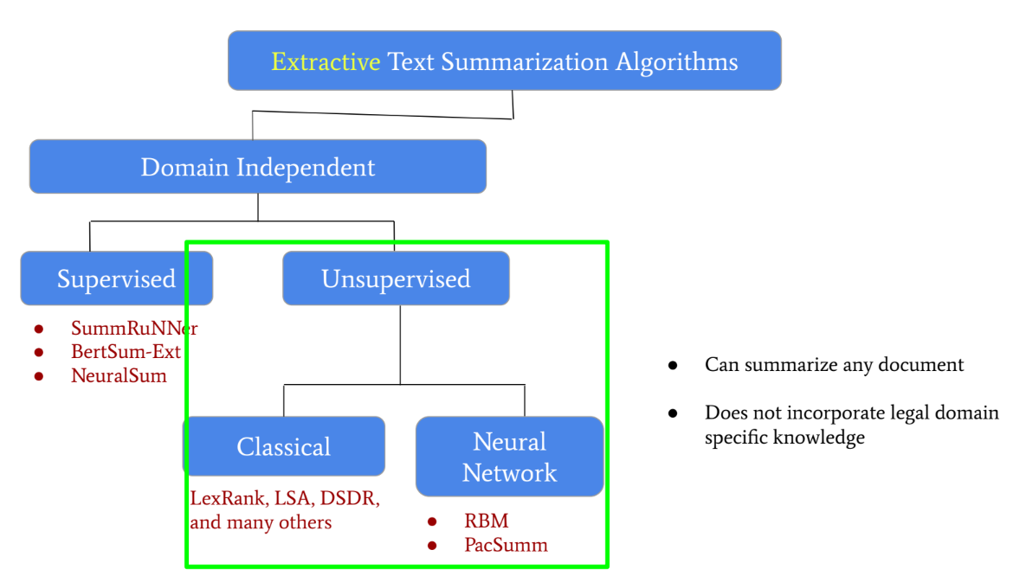
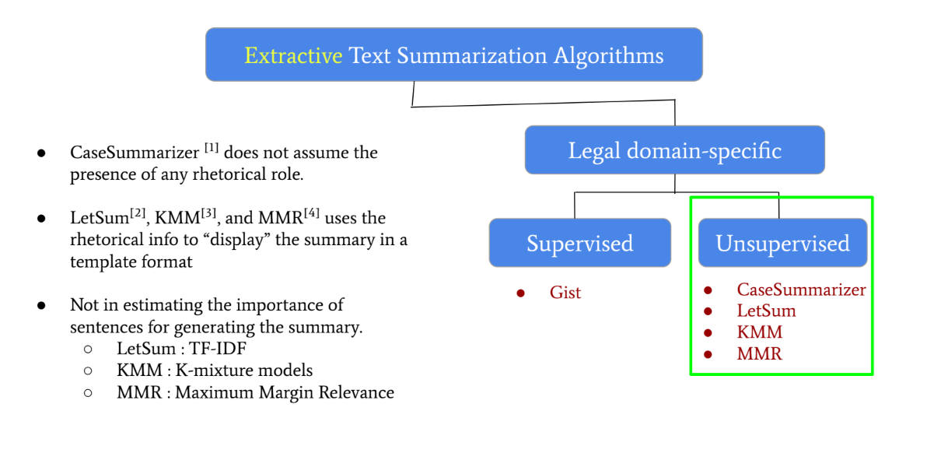
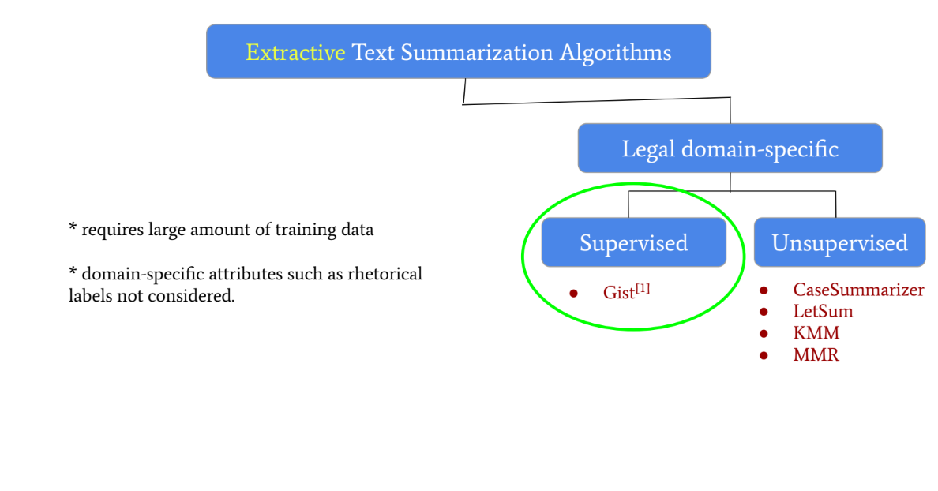
[1] Polsley et.al., CaseSummarizer: A System for Automated Summarization of Legal Texts, COLING 2016
[2] Farzindar et.al., Letsum, an automatic legal text summarizing system, JURIX 2004
[3] Saravanan et.al., Improving Legal Document Summarization Using Graphical Models, JURIX 2006
[4] Zhong et.al., Automatic Summarization of Legal Decisions Using Iterative Masking of Predictive Sentences, ICAIL 2019
[5] Liu et.al., Extracting the Gist of Chinese Judgments of the Supreme Court, ICAIL 2019

Slide 10
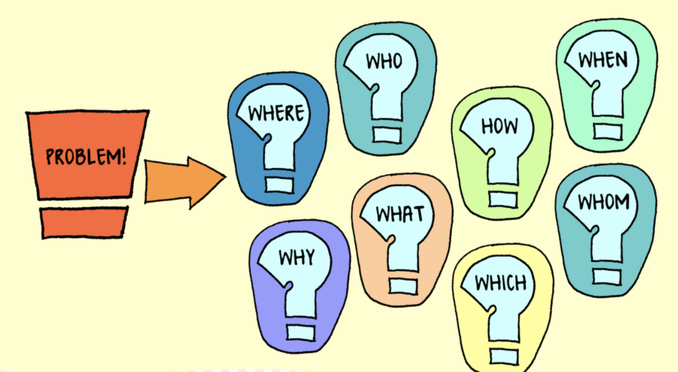
Problems observed in State-of-the-Art Techniques/Works
Existing algorithms do not use legal domain-specific knowledge systematically.
Supervised methods are expected to learn these rules automatically and scarcity of expert-written summaries in large amounts to be used as training data.
Summary requirement may vary for different stakeholders and therefore huge amounts of training data for each type needs to be gathered.
Note: Domain knowledge is knowledge of a specific, specialized discipline or field, in contrast to general (or domain-independent) knowledge.

Slide 11
Motivation
Existing legal systems employ attorneys/para-legals to manually write summaries.
Legal text are lengthy, free-flowing, unstructured and dense which makes reading and comprehending the full documents difficult even for lawyers.
Automatic summarization systems improves the overall legal understanding with lesser dependence upon experts.
Improves understanding
Lesser dependence upon experts

Slide 12
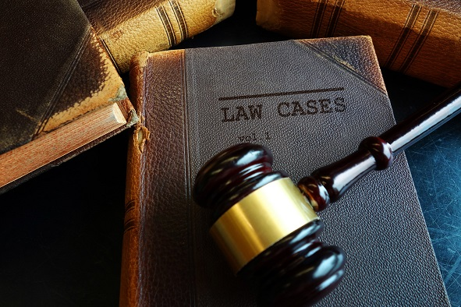
Exact Problem to Solve
Developing an unsupervised extractive vs. abstractive Legal Case Summarization system by using Legal Domain Knowledge

Slide 13
Difference of work done in second semester and current semester
In the second semester, Dr. Muskaan Singh was my Supervisor and under her supervision, my thesis was on “Decision Prediction and Meta-review Generation of Research articles” .
This semester, under the supervision of Dr.Naveen Saini, I am Investigating Text Summarization of Legal Case Documents using Domain Knowledge by applying different AI/ML algorithms.

Slide 14
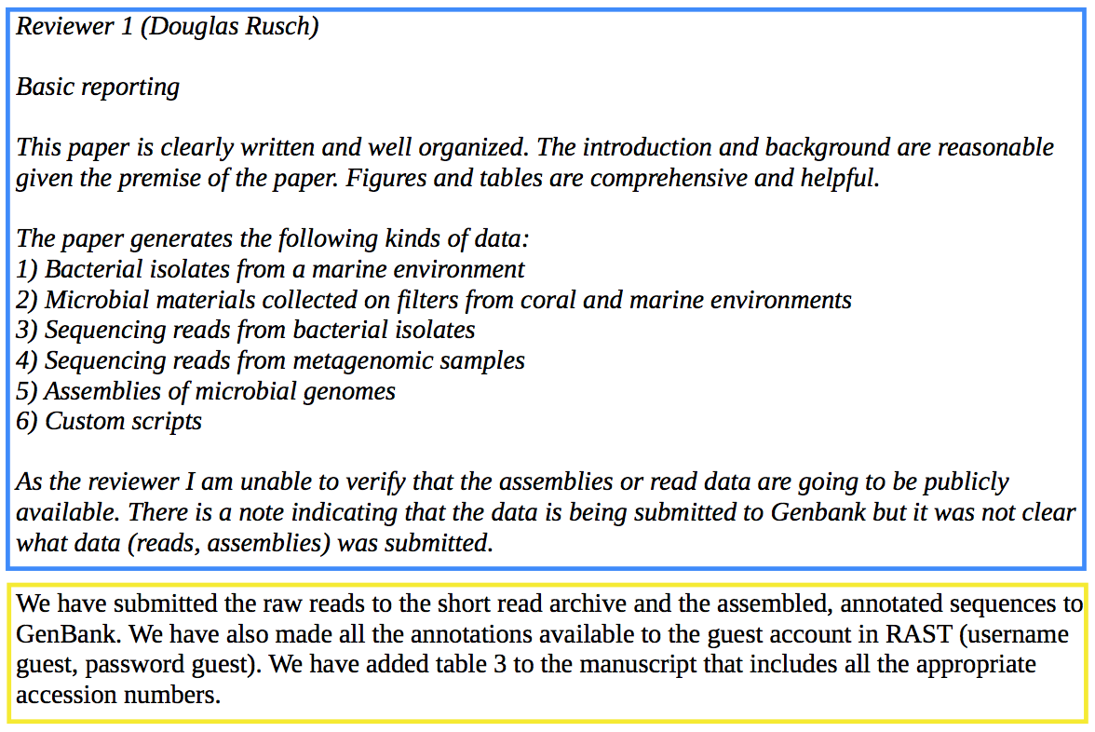
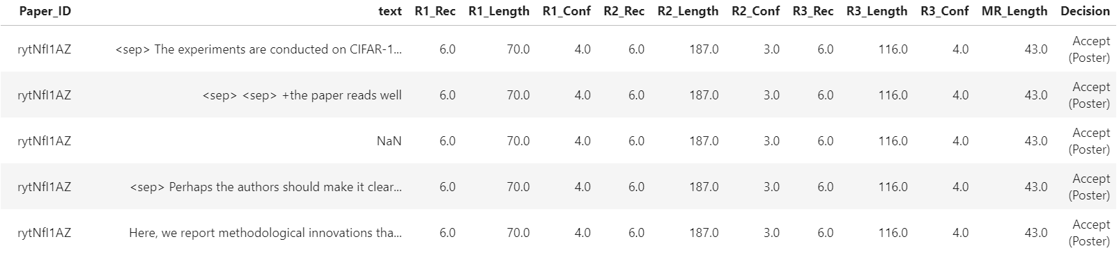
[1]
Flow Diagram of previous work
Review-rebuttal Pair
Decision Prediction
Meta-review generation
Dataset

Slide 15
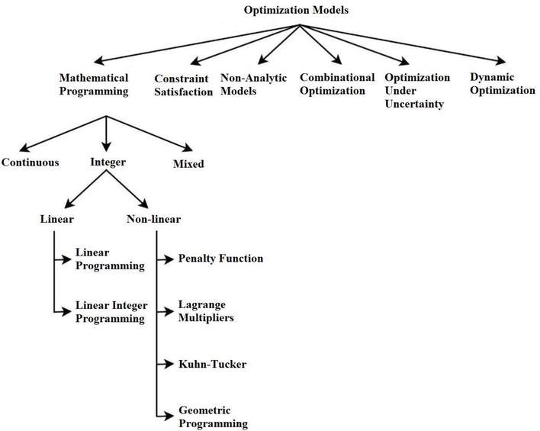
Novelty of Work
Incorporating Legal Domain Knowledge in developing extractive/abstractive summarization system.
In the base paper, the summary is generated using the (weighted) sum approach. But in our approach we want to optimize them simultaneously.
Use of an evolutionary technique as the underlying optimization technique. This task is still unexplored.
Used in base paper

Slide 16
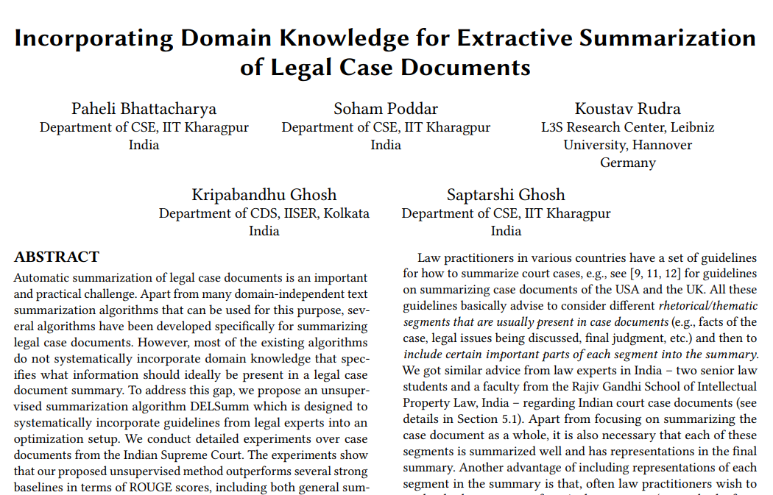
Methodology
In general, the summary should contain representations from all segments of a case document. The relative importance of segments in a summary should be:
Final judgment > Issue > Fact > (Statute, Precedent, Ratio) > Argument
Informativeness of a sentence I(i) : amount of important information contained in a sentence
Content words: Content words signify domain-specific vocabulary
Score ( j ) = importance of each content word j
[2]

Slide 17



Methodology
Facts
Issue
Final Judgement
Optimize with evolutionary Algorithm
Abstractive summary
Extractive Summary
Legal Case Document
Technique:
Optimization framework to apply legal domain knowledge into an objective function with constraints.
Going to explore different metaheuristic search algorithms to find the best way to maximize the objective function.

Slide 18
Experimental Setup: Dataset, Parameters and Evaluation Measures
The used Dataset in the Base Paper
50 Indian Supreme Court Case Documents
Each sentence labelled with one of the 8 label segments
Gold standard summaries of the 50 docs
By two senior law students (from the Rajiv Gandhi School of Intellectual Property Law)
Evaluation Measures/Metrics
ROUGE scores between the gold standard summaries & the algorithmic summaries.

Slide 19
Evaluation Metrics Used
ROUGE-N measures the number of matching n-grams between the model-generated text and a human-produced reference.
Used is Rouge-2 using 2-grams.
ROUGE-L is based on the longest common subsequence (LCS) between model output and reference, i.e. the longest sequence of words (not necessarily consecutive, but still in order) that is shared between both. A longer shared sequence should indicate more similarity between the two sequences.

Slide 20
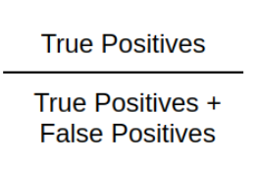
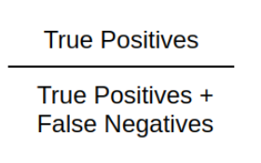
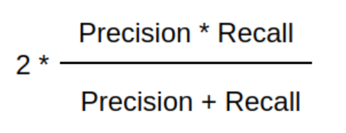
Precision: Precision is a measure of how many of the positive predictions made are correct (true positives).
Recall: Recall is a measure of how many of the positive cases the classifier correctly predicted, over all the positive cases in the data.
F1 Score: F1-Score is a measure combining both precision and recall.

Slide 21
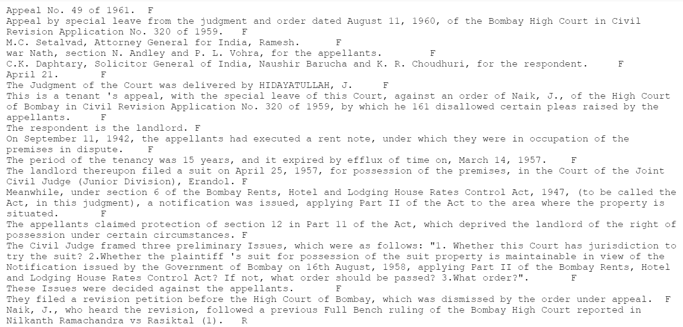
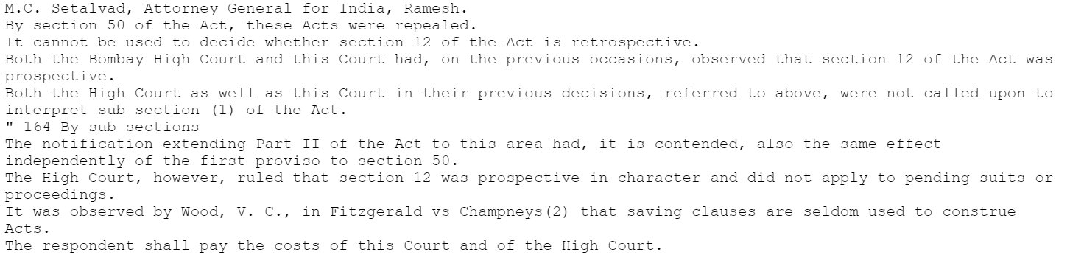


Results and Comparative Analysis
Text Data
Generated Summary
FACTS

Slide 22
LIMITATIONS OF the WORK
The used dataset must have labelled segmentations for better Rouge Scores since it is domain specific.

Slide 23
Future Research Plan
Currently I am still investigating methods to implement my project. After its successful implementation, I wish to extend this project and reduce drawbacks in this project.

Slide 24
Tentative Timeline
oct 2022
Exploring Abstractive summarization AND STARTING TO WRITE THE PAPER
SEP 2022
Exploring different optimization algorithms
nov 2022
EXTENSION TO a Larger dataset
dec 2022
Paper completion
jan 2022
Paper submission

Slide 25
Conclusion
I wish to incorporate Domain Knowledge for extractive and abstractive Legal Text Summarization.
Domain Knowledge is necessary because important segments like Final Judgement Issue gets missed in otherwise un-guided algorithms
It achieves a balanced representation, and handles redundancy
By using an evolutionary technique, I wish to optimize the objective function and get better Rouge scores than the existing base-line.

Slide 26
References
[1] Pradhan, Tribikram, et al. “A Deep Neural Architecture Based Meta-Review Generation and Final Decision Prediction of a Scholarly Article.” Neurocomputing, vol. 428, Elsevier BV, Mar. 2021, pp. 218–38. Crossref, https://doi.org/10.1016/j.neucom.2020.11.004.
[2] Bhattacharya, Paheli, et al. “Incorporating Domain Knowledge for Extractive Summarization of Legal Case Documents.” Proceedings of the Eighteenth International Conference on Artificial Intelligence and Law, New York, NY, USA, ACM, June 2021. Crossref, https://doi.org/10.1145/3462757.3466092.
[3] Bhattacharya, Paheli, et al. “Legal Case Document Similarity: You Need Both Network and Text.” Information Processing &amp; Management, vol. 59, no. 6, Elsevier BV, Nov. 2022, p. 103069. Crossref, https://doi.org/10.1016/j.ipm.2022.103069.
[4] Bhattacharya, Paheli, et al. “DeepRhole: Deep Learning for Rhetorical Role Labeling of Sentences in Legal Case Documents.” Artificial Intelligence and Law, Springer Science and Business Media LLC, Nov. 2021. Crossref, https://doi.org/10.1007/s10506-021-09304-5.
[5] Saravanan, M., and B. Ravindran. “Identification of Rhetorical Roles for Segmentation and Summarization of a Legal Judgment.” Artificial Intelligence and Law, vol. 18, no. 1, Springer Science and Business Media LLC, Mar. 2010, pp. 45–76. Crossref, https://doi.org/10.1007/s10506-010-9087-7.

Slide 27
Thank you
Shreya Goswami
MCS21023
mcs21023@iiitl.ac.in

